Slide 1
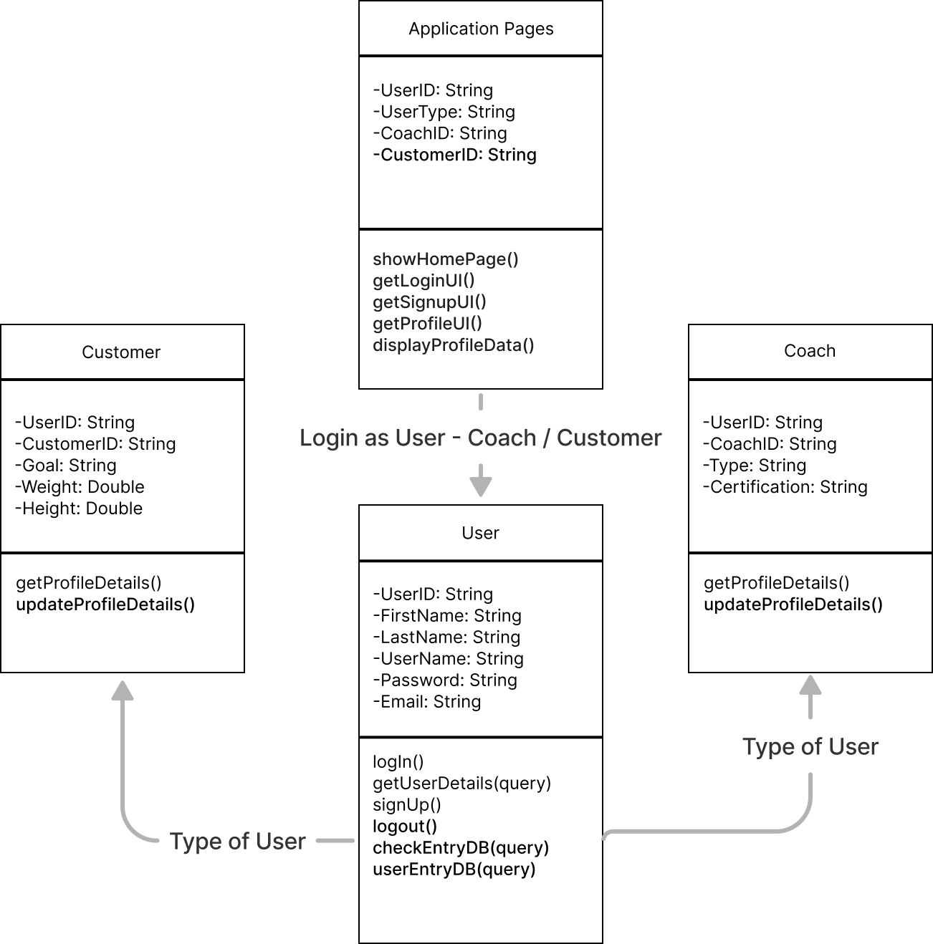
Class Diagram (UML) - Health Application (Team 4)

